Slide 1
Rumusan Rps obe

Slide 2
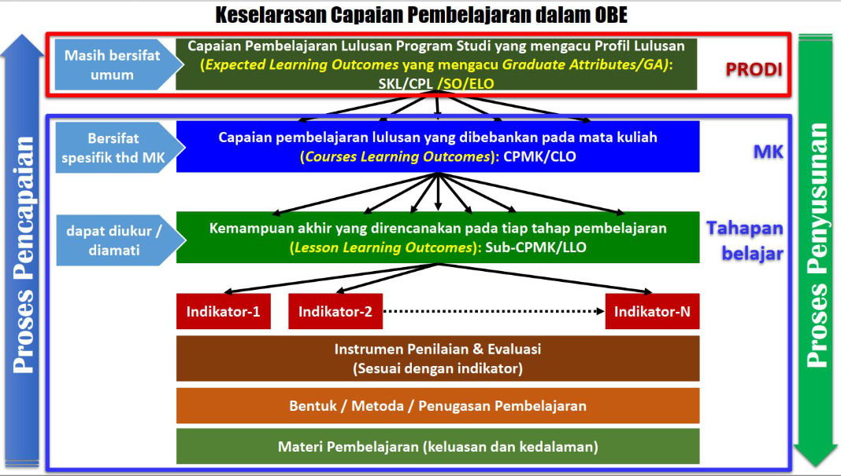

Slide 3
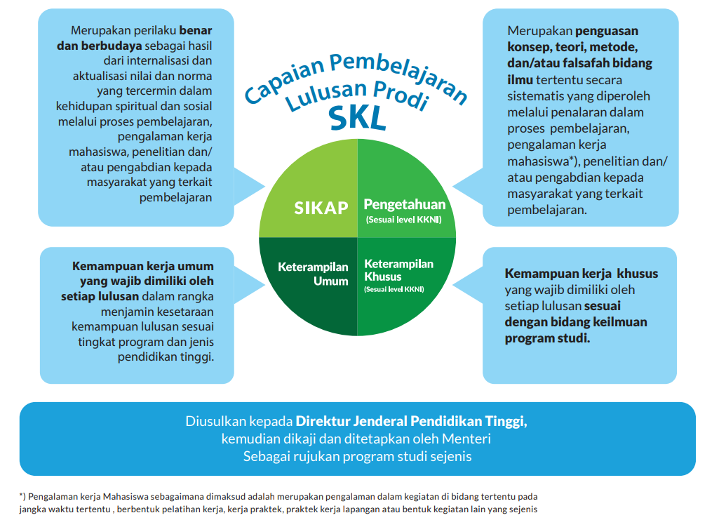
Introduction
At Contoso, we empower organizations to foster collaborative thinking to further drive workplace innovation. By closing the loop and leveraging agile frameworks, we help business grow organically and foster a consumer-first mindset.

Slide 4
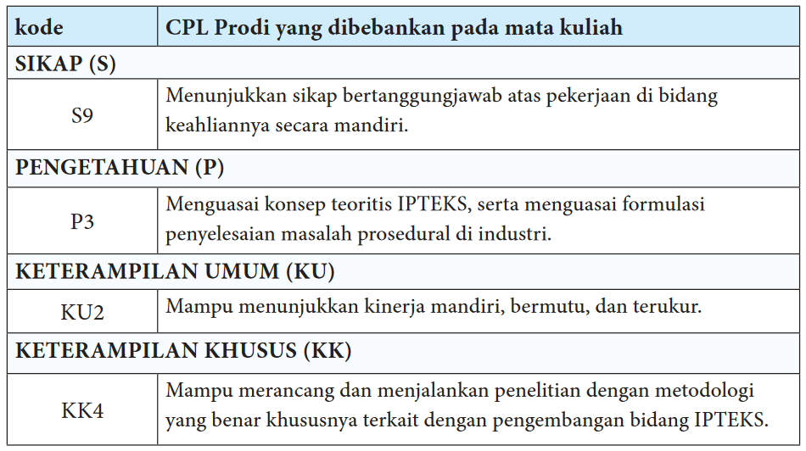
Introduction
At Contoso, we empower organizations to foster collaborative thinking to further drive workplace innovation. By closing the loop and leveraging agile frameworks, we help business grow organically and foster a consumer-first mindset.

Slide 5
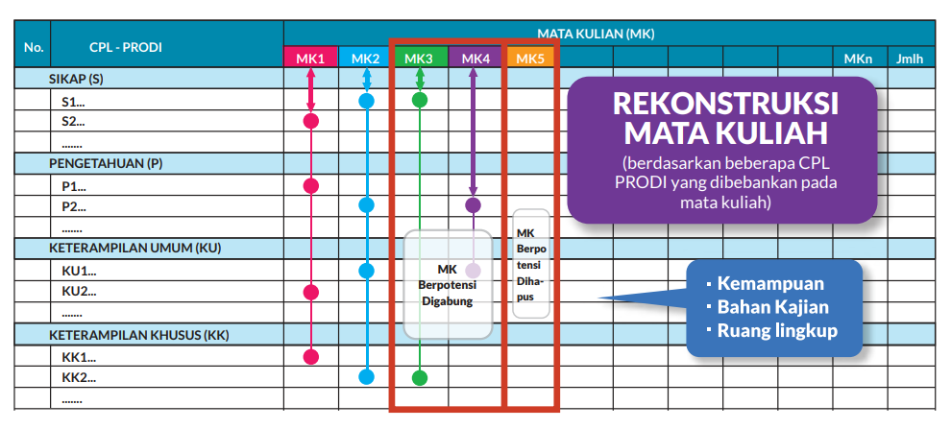
Matriks untuk Evaluasi Mata Kuliah

Slide 6
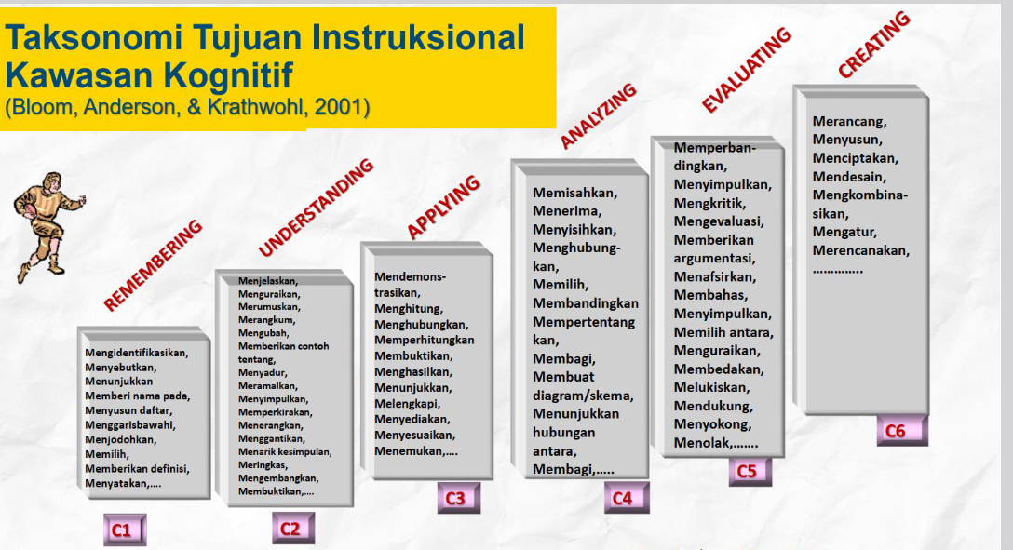

Slide 7
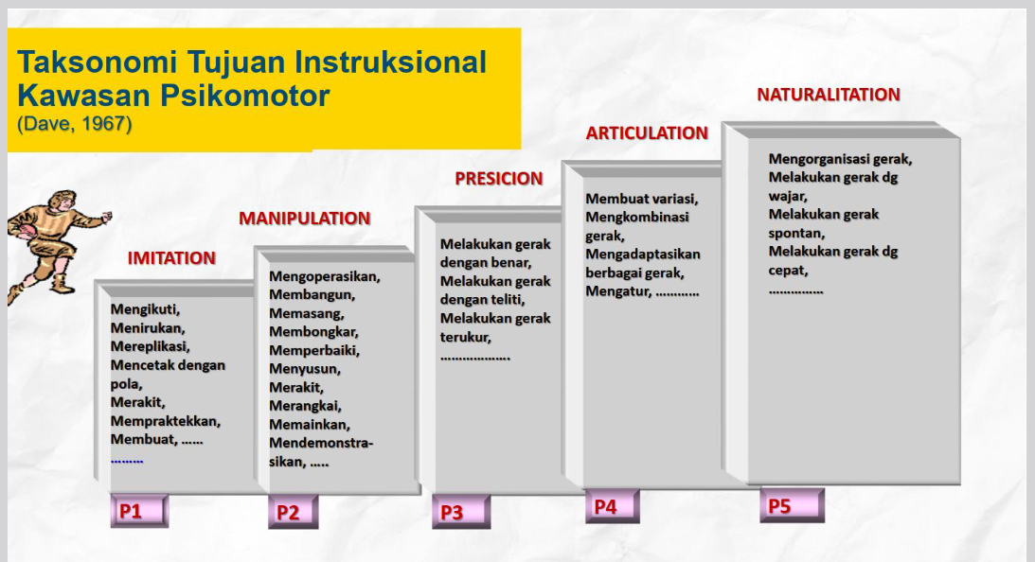

Slide 8
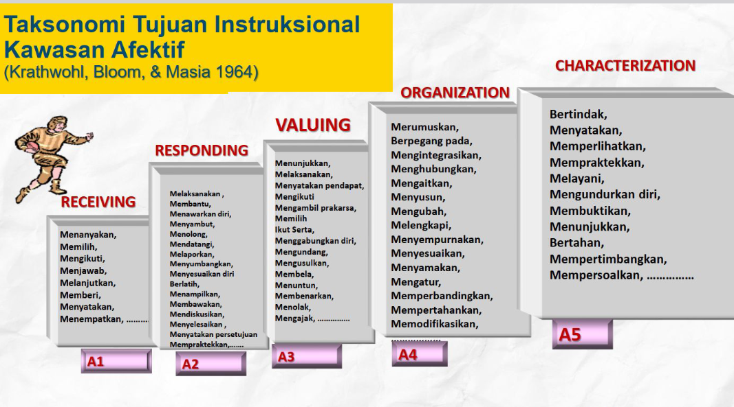

Slide 9
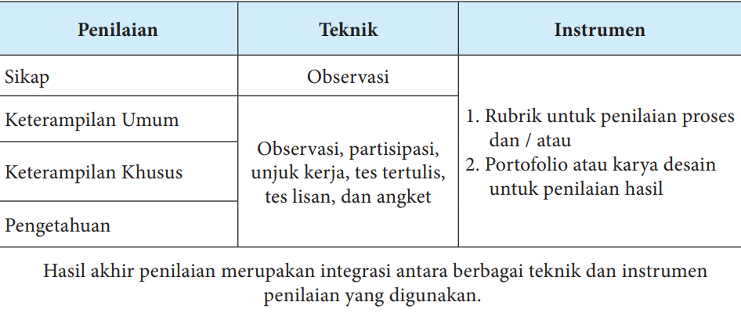
AREAS OF GROWTH
 | B2B | Supply chain | ROI | E-commerce
Q1 | 4.5 | 2.3 | 1.7 | 5.0
Q2 | 3.2 | 5.1 | 4.4 | 3.0
Q3 | 2.1 | 1.7 | 2.5 | 2.8
Q4 | 4.5 | 2.2 | 1.7 | 7.0

Slide 10
THANK YOU

